Slide 1
피보나치 수열 알고리즘 분석
백석대학교 강윤희
Notes:
https://www.geeksforgeeks.org/python-program-for-program-for-fibonacci-numbers-2/

Slide 2
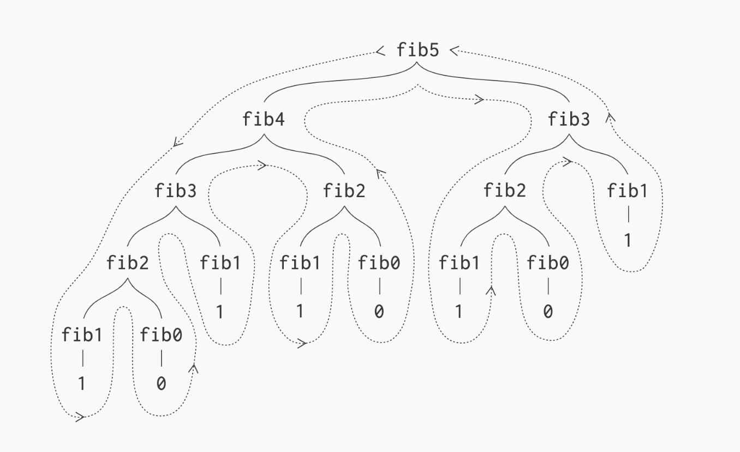
(재귀)피보나치 수열
def Fibonacci(n):
if n<0:
print("Incorrect input")
# First Fibonacci number is 0
elif n==1:
return 0
# Second Fibonacci number is 1
elif n==2:
return 1
else:
return Fibonacci(n-1)+Fibonacci(n-2)
# Driver Program
print(Fibonacci(5))
점화식 표현
fib(i) = fib (i-1) + fib (i-2)

Slide 3
for n > 1:
T(n) = T(n-1) + T(n-2) + 4 (1 comparison, 2 subtractions, 1 addition)
T(n) = T(n-1) + T(n-2) + c
= 2T(n-2) + c //from the approximation T(n-1) ~ T(n-2)
= 2*(2T(n-4) + c) + c
= 4T(n-4) + 3c
= 8T(n-6) + 7c
= 2^{k} * T(n - 2k) + (2^{k} - 1)*c
Let's find the value of k for which: n - 2k = 0
k = n/2
Notes:
https://medium.com/@syedtousifahmed/fibonacci-iterative-vs-recursive-5182d7783055

Slide 4
T(n) = T(n-1) + T(n-2) + c
= 2T(n-1) + c //from the approximation T(n-1) ~ T(n-2)
= 2*(2T(n-2) + c) + c
= 4T(n-2) + 3c
= 8T(n-3) + 7c
= 2^{k} * T(n - k) + (2^{k} - 1)*c
n - k = 0
k = n
T(n) = 2^{n} * T(0) + (2^{n} - 1)*c
= 2^{n} * (1 + c) - c
i.e. T(n) ~ 2^{n}

Slide 5
(동적 프로그래밍) 피보나치 수열
불필요한 재귀호출 제거
FibArray = [0,1]
def fibonacci(n):
if n<0:
print("Incorrect input")
elif n<=len(FibArray):
return FibArray[n-1]
else:
temp_fib = fibonacci(n-1)+fibonacci(n-2)
FibArray.append(temp_fib)
return temp_fib
T(n) = T(n-1) + c = T(n-2) + 2c = T(n-3) + 3c = T(n-k) + kc
n - k = 0 k = n
T(n) = T(0) + nc = nc + 1

Slide 6
(동적 프로그래밍) 피보나치 수열
최적화
def fibonacci(n):
a = 0
b = 1
if n < 0:
print("Incorrect input")
elif n == 0:
return a
elif n == 1:
return b
else:
for i in range(2,n):
c = a + b
a = b
b = c
return b

